Slide 1
Word List: graph = writing

Slide 2
What is the root that means writing?

Slide 3
the root graph

Slide 4
What is the word that names the part of a piece of writing that begins with a topic sentence, describes the topic in detail, then ends with a concluding sentence?

Slide 5
paragraph
a section of writing that has a topic and concluding sentence

Slide 6
What is the word that names the type of book that was written about a person’s life but was written by a different person than the subject of the book?

Slide 7
biography
a book written about a person’s life

Slide 8
What is the word that names the device that scientists who study earthquakes will look at when they want to know how strong an earthquake was?

Slide 9
seismograph
a device that writes down (records) the movements of the earth

Slide 10
What is the word that names the science of mapmaking?

Slide 11
cartography
mapmaking; the writing involved in making maps or charts

Slide 12
What is the word that names the machine that turns the writing on plastic disks (records) into music that you can hear?

Slide 13
phonograph
record player; a device that turns the writing on records into sound

Slide 14
What is the word that names what someone has written when he or she has signed his or his name on something?

Slide 15
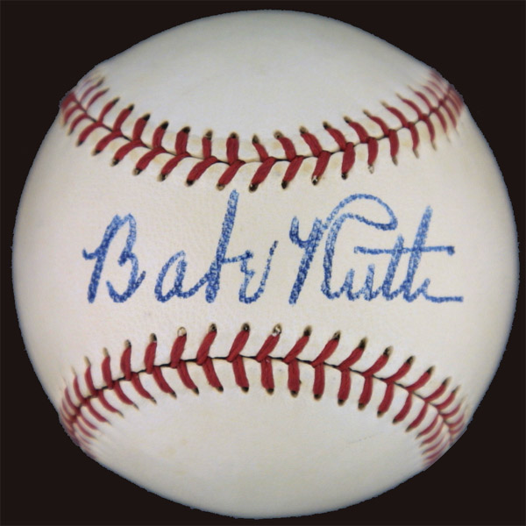
autograph
the writing of one’s name

Slide 16
What is the word that names the hobby or study of how light records an image using a camera?

Slide 17
photography
the use of light to record an image using a camera

Slide 18
What is the word that names the type of book that is about a person’s life and was written by that actual person?

Slide 19
autobiography
writing about a person’s life written by that person

Slide 20
What is the word that labels two words that are spelled the same ubt usually have different meanings based on how you say them?

Slide 21
homograph
a word written the same way as another word but having a different meaning (e.g., bow--hair and bow—ship)

Slide 22
What is the word that names the page at the end of a book report that tells the reader which books were studied to create the piece of writing?

Slide 23
bibliography
the written list of all the books used in a report or book

Slide 24
END!

